Slide 1

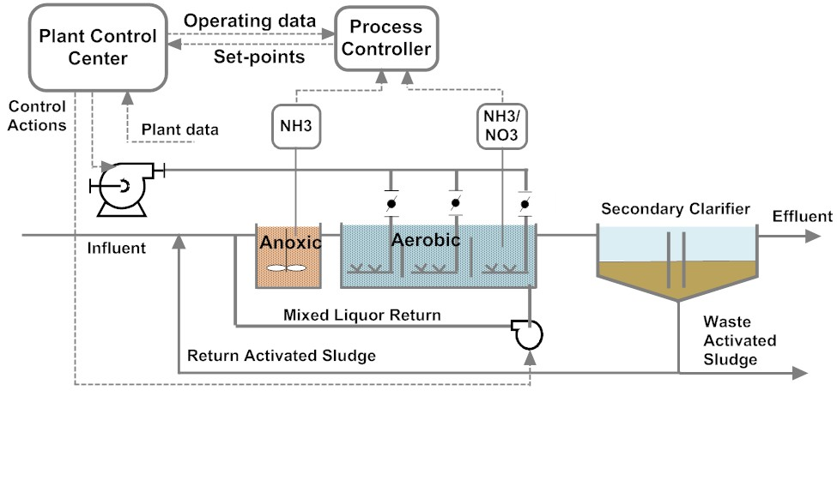
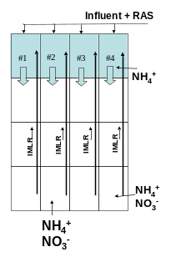
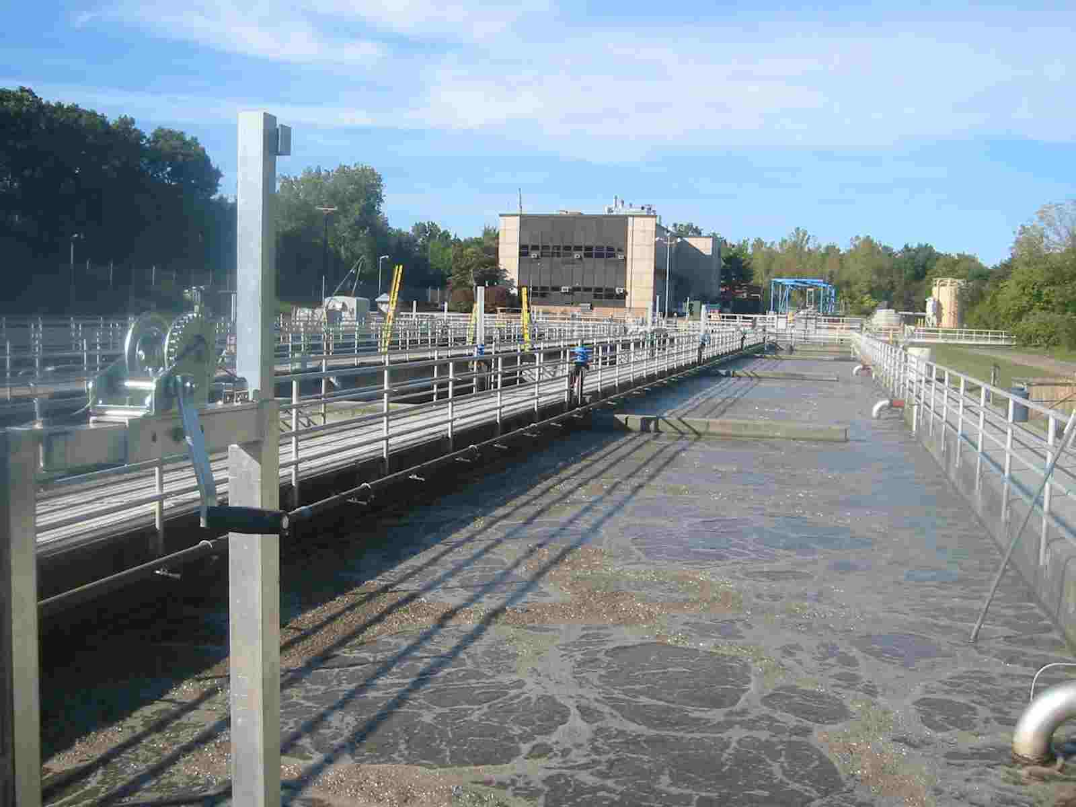
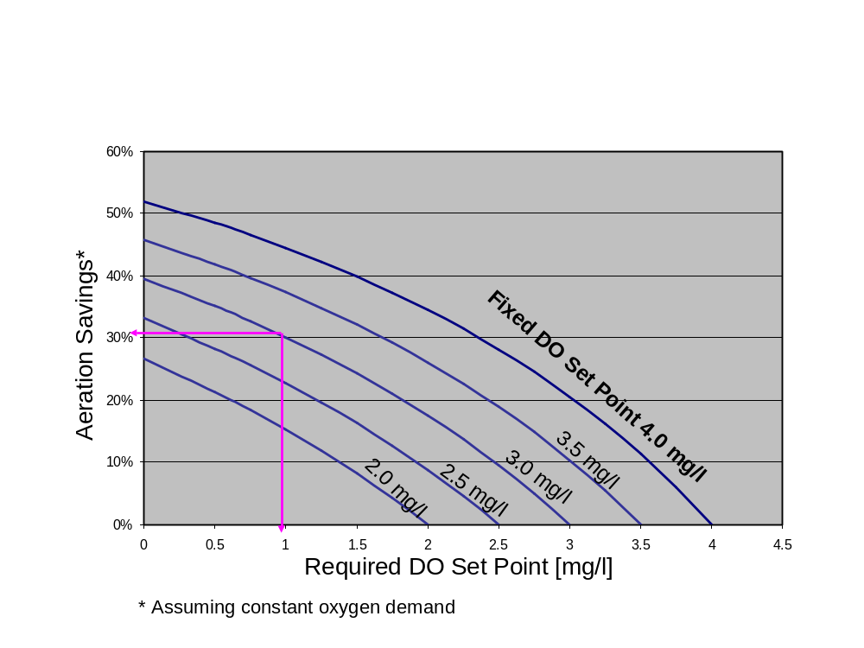
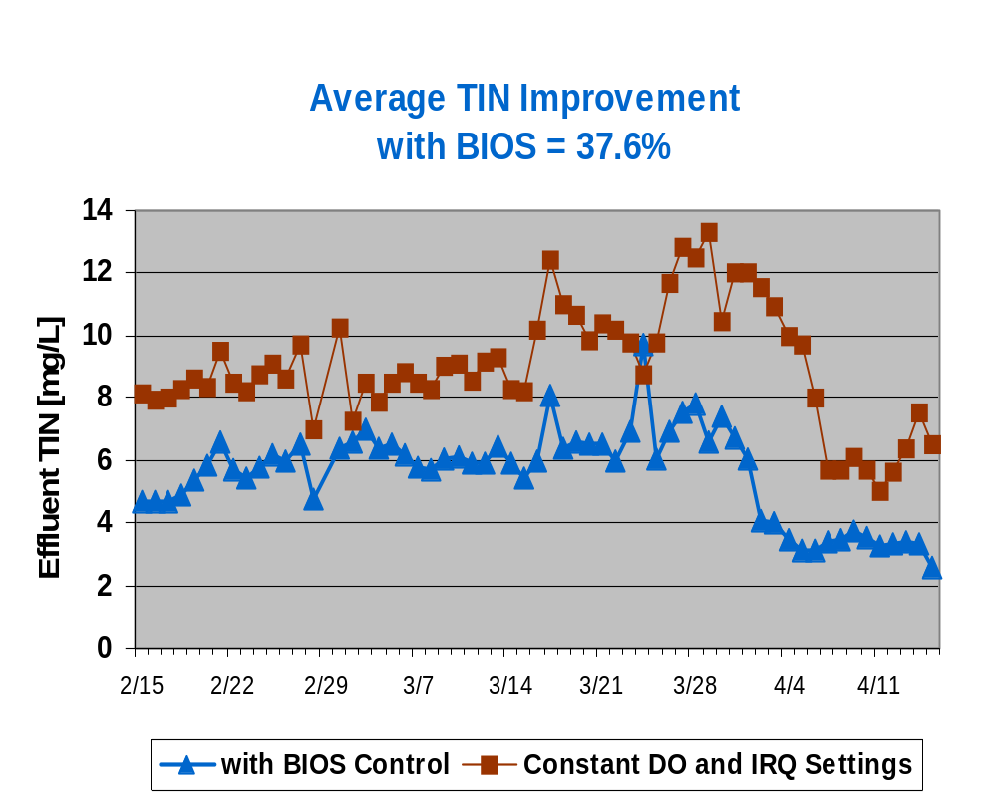
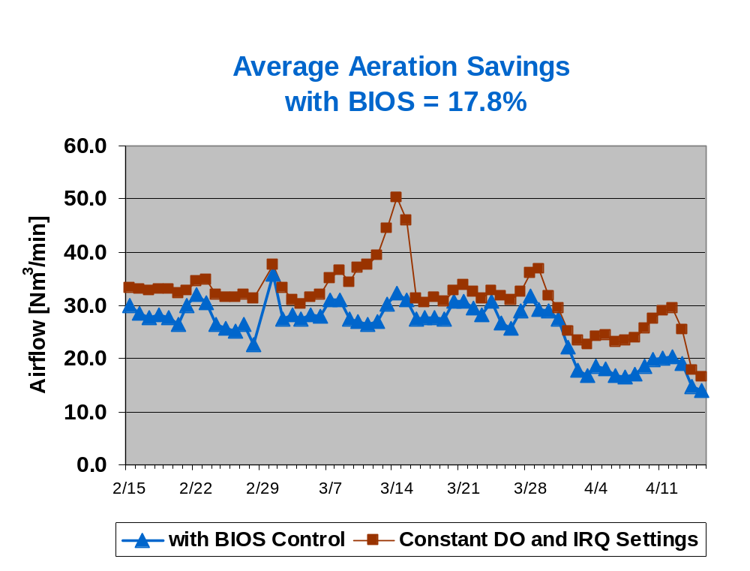
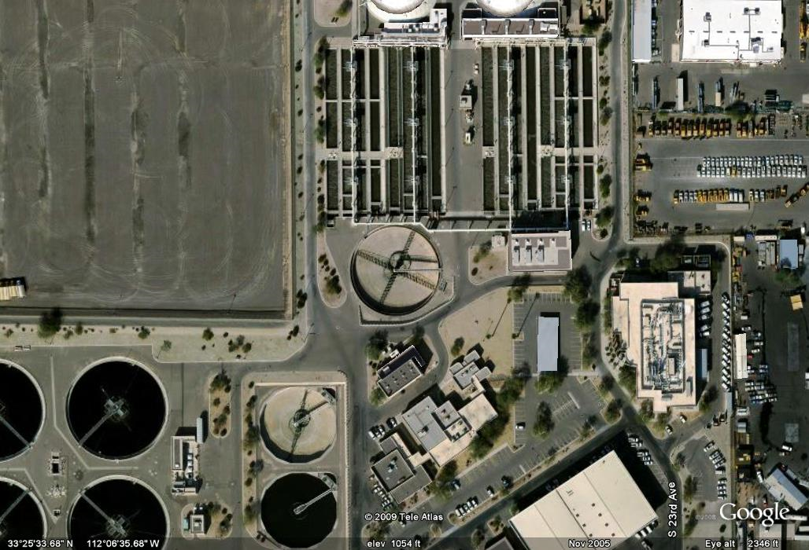
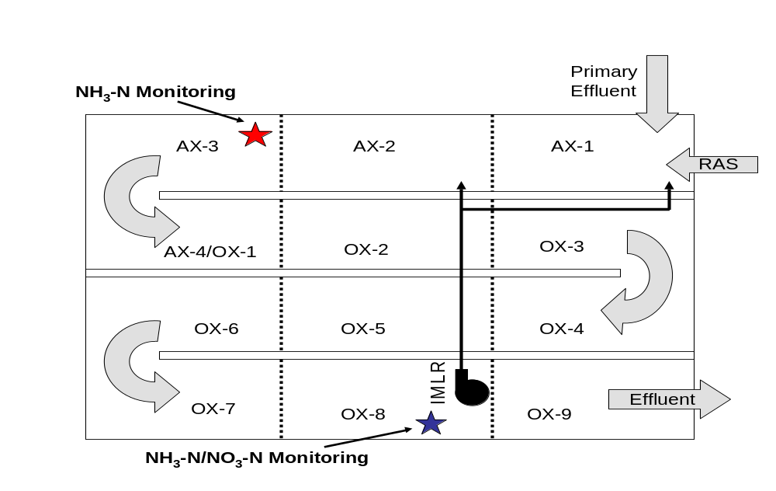
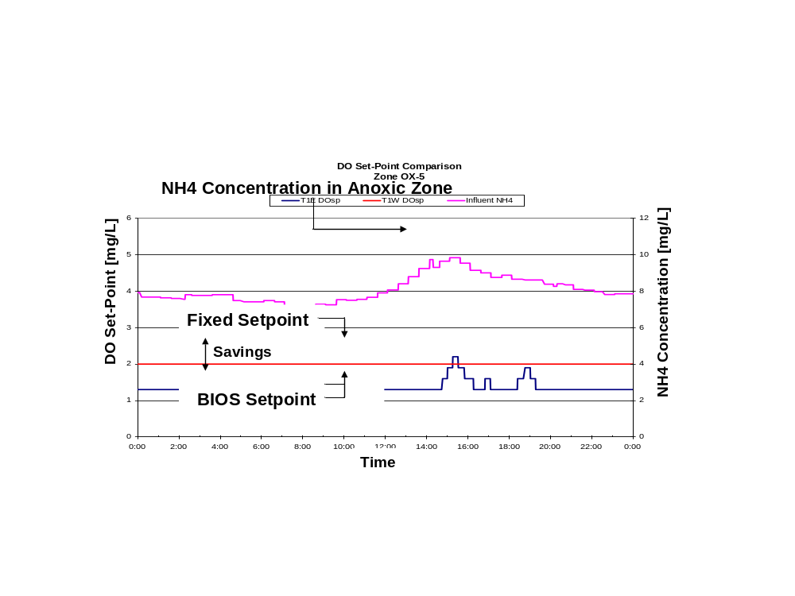
Energy Reduction and Nitrogen Removal Through Model-based Feed-forward Control of Activated Sludge Plants in Arizona and Connecticut
Dipl.-Ing. Tilo Stahl, Ph.D., and George Lee,
BioChem Technology, Inc., King of Prussia, PA, USA
1. Kurzfassung
Ein feed-forward Prozessregler optimiert den Sauerstoffsollwert und die interne Kreislaufrate im Belebungsbecken auf der Basis eines mathematischen Modells des Klaerwerks und der gemessenen Zulauffracht. In vorliegender Publikation wird der Einsatz des feed-forward Prozessregler vorgestellt am Beispiel von Projekten in Phoenix, Arizona und in Connecticut. Bei den Projekten konnte ueber 15% der Belueftungsenergie eingespart werden, und Gesamtstickstoff im Ablauf um ueber 30% reduziert werden.
Abstract
A feed-forward, model-based process controller matches dissolved oxygen (DO) set-points and mixed liquor recycle (IMLR) rates in real time to the influent loading. This paper discusses the monitoring technology, and optimization and control techniques used in projects in Phoenix, Arizona and in Enfield, Connecticut. The results of the projects showed that over 15% of aeration energy can be saved and Total Nitrogen removal can be improved by over 30%.
2. Feed-Forward Control Methodology
BioChem Technology Inc’s Bioprocess Intelligent Optimization System (BIOS) is a monitoring and control system that uses sophisticated feed-forward control algorithms to calculate optimal operational conditions for the nitrifying/denitrifying activated sludge treatment process. The system receives input data from nutrient analyzers in the anoxic zone and at the end of the aeration zone, as well as operating data (flow rates, temperatures, DO, MLSS) from the plant control center.
The controller uses a customized version of the Activated Sludge Model No.1 (ASM 1) [1] to model the plant and simulate the plant response to influent changes at the current operating conditions in real time. The important kinetic parameters in the algorithm are calibrated based on the measurements of specific maximum nitrification rate (consisting of maximum ammonia uptake rate plus maximum ammonia utilization rate) and specific maximum nitrate utilization rate. The controller uses an optimization algorithm to determine the optimal set-points for dissolved oxygen (DO) and Internal Mixed Liquor Recycle (IMLR) rate to achieve treatment goals while minimizing energy consumption, and sends the set-points to the plant control center for implementation.
Results at Phoenix 23rd Avenue WWTP
The tests demonstrated savings between 11.5% and 18.3% (Table 1), with an average aeration savings of 15.3%, without any deterioration of plant performance. The savings can also be expressed as 31.1 kWh per 1000 m³ of treated flow. At a cost of $0.10 per kWh the calculated savings are $206,000 per annum.
Trial | BIOS | Duration [Days] | Measured kWh/(10³m³) | Difference kWh/(10³m³) | Savings One Train | Calculated Savings Four Trains
1 | ON | 8 | 191.7
 | OFF | 7 | 200.9 | 9.2 | 4.6% | 18.3%
2 | OFF | 11 | 204.2 | 5.9 | 2.9% | 11.5%
 | ON | 11 | 198.3
 | OFF | 11 | 206.5 | 8.2 | 4.0% | 16.0%
Average |  |  |  | 7.77 | 3.82% | 15.3%
Table 1: Energy savings at 23rd Avenue WWTP
Figure 1 shows a typical controller configuration in a Modified-Ludzak-Ettinger (MLE) process, which employs a combination of an anoxic and aerobic zone. Nitrification occurs in the aerobic zone and the mixed liquor, high in nitrate from nitrification, is recycled to the anoxic zone (by the Mixed Liquor Recycle) for denitrification. The ammonia analyzer in the anoxic zone measures plant loading, and an ammonia/nitrate analyzer at the end of the aeration zone is used for IMLR control, verification of the model and auto-calibration.
4. Enfield, CT Wastewater Treatment Plant
The secondary treatment process at the Enfield, Connecticut WWTP treats approximately 870 m³/h (~ 138,000 EW). It is configured as an MLE process in four parallel trains. (Figure 6).
Prior to installing the feed forward process control, the WWTP operated its MLE process using constant DO set-points of 2.75 mg/l, 2.0 mg/l, and 0.5 mg/l for aerobic zones 1, 2, and 3, respectively. It also maintained a constant IMLR ratio of 275% to the anoxic zone. In a pilot study, one train was equipped with the advanced process control system, and the results over a two month period were compared with a control train. The side by side comparison study demonstrated that the total nitrogen removal was improved by 37% and the aeration requirement was decreased by 18% (Figure 7). The feed forward control system has been controlling all four process trains since June, 2004 [3].
Figure 1: Typical MLE process showing analyzer locations and controller configuration
The benefits of the advanced control system include:
1) Reduced Electricity Consumption. It is possible to reduce the aeration energy by lowering the DO set-point to a level sufficient to achieve the desired level of nitrification without over-aerating. Oxygen transfer efficiency is significantly higher at lower dissolved oxygen concentrations [2], resulting in significant electricity savings (Figure 2).
2) Reduced Total Nitrogen Effluent Levels. The advanced control system contributes to reducing nitrate levels by controlling IMLR rates to optimize performance of the anoxic zones based on the actual denitrification rate. Maximizing denitrification additionally saves aeration energy by maximizing the oxygen credits from the nitrates.
Figure 2: Aeration savings as a result of DO set-point reduction
Figure 6: Enfield WPCF Layout, showing location of ammonia and nitrate analyzers
3. Phoenix 23rd Avenue Wastewater Treatment Plant
Project Description
The advanced process controller was installed at the 23rd Avenue Wastewater Treatment Plant (WWTP) (Figure 3). The plant is rated for a design influent flow of 10,000 m³/h, with a current average flow of 7,500 m³/h (~ 1.2 Mio EW). Secondary treatment consists of four parallel, identical process trains configured as an MLE process (Figure 4). Aeration air to each aeration zone is centrally controlled. Automatic control of the mixed liquor recycle was not implemented because total nitrogen removal was not a plant objective.
A typical control response to changes in influent loading is shown in Figure 5. It shows the DO set-point provided by the controller to the Plant Control Center in the middle aeration zone (OX-5) as a result of the ammonia loading (pink line) in the anoxic zone. The red line shows the operator defined set-points for the individual zone as used in the control experiments. The blue line shows the DO set-point output from the controller. Note that the operator specified a lower set-point limit of 1.3mg/l. It can be seen that the controller operated at the lower set-point limit for most of the day, responding to an increase in ammonia loading by increasing the set-point. The area between the fixed set-point and the controlled set-point is a measure of the aeration energy savings.
Figure 7: Effluent Total Inorganic Nitrogen and total airflow with and without control over 2 month period
Figure 3: Phoenix 23rd Avenue WWTP
5. Results and Conclusions
Load-based feed-forward control of DO and IMLR in an activated sludge wastewater treatment plant can provide measurable and consistent energy savings through reduced aeration requirements without jeopardizing effluent quality, and improved nitrogen removal. In the cases presented here, aeration energy savings were in the range of 15% to 18%, and Total Nitrogen removal improved by over 35%.
6. References
[1] Henze, M., C.P.L. Grady, W. Gujer, G.v.R. Marais, T. Matsuo: Activated Sludge Model No.1. IAWPRC Scientific and Technical Report No.1. IAWPRC task group on mathematical modelling for design and operation of biological wastewater treatment. London 1987.
[2] U.S. Environmental Protection Agency Design Manual - Fine Pore Aeration Systems. EPA/625/1-89/023. Cincinnati, OH 1989
[3] Liu, W., G.J.F. Lee, P.E. Schloth, M.E. Serra Side by Side Comparison Demonstrated a 36% Increase of Nitrogen Removal and 19% Reduction of Aeration Requirements Using a Feed Forward Online Optimization System. Proceedings of WEFTEC 2005, Washington, DC 2005
Figure 4: Layout of secondary treatment tank
Figure 5: Typical Control response in the middle of the aeration basin, with an operator limited lower setpoint of 1.3 mg/L

